Slide 1
__ ____ __ \ \/ / _\/ _\ \ /\ \ \ \ / \_\ \_\ \ /_/\_\__/\__/

Slide 2
Description
The classic code vs. data problem
User input (data) is interpreted as code and executed
Never trust user input!!
Types:
Reflected
Stored/Persistent
DOM based

Slide 3
First a Step Back – HTML Rendering
Overview
A browser sends a request to the server
The server responds and the response body contains HTML
The HTML is parsed by the browser and rendered and displayed on the screen
Note: we are intentionally breezing over CSS, JS, images, etc. for the time being

Slide 4
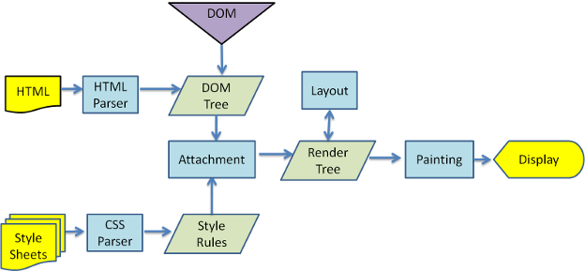
HTML Rendering
Webkit rendering flow

Slide 5
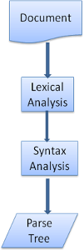
HTML Parsing
Parsing consists of two functions
Lexical Analysis (Lexer)
Break input into tokens
Syntax Analysis (Parser)
Applying language syntax rules

Slide 6
Lexical Analysis
Sometimes called “tokenization”
The basic algorithm is a state machine
Each state leads to the next state
Each character affects the processing of the next character
The same character can be interpreted differently depending on the state of the state machine

Slide 7
Lexical Analysis - Example
Given the following HTML
<html>
<body>
Hello world
</body>
</html>
The following Lexical Analysis occurs
The initial state is the “data state”
When the “<“ character is encountered the state changes to “tag open state”
Consuming an “a-z” character causes creation of a “start tag token” and the state is changed to “tag name state”
The “tag name state” occurs until the “>” character is hit. Each character before that is part of the tag’s name
When the “>” is hit the state reverts to the “data state”
“<body>” tag is treated the same
“Hello world” will be processed as character tokens until the “<“ is hit
“<“ will cause a “tag open state”
The “/” will cause the creation of an “end tag token” and the state will enter “tag name state” until the “>” is reached, then state will become “data state”
“</html>” is treated the same

Slide 8
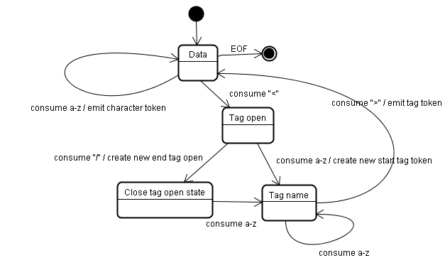

Slide 9
Syntax Analysis
The Document Object Model (DOM) tree is constructed
The Document is the root of the tree, elements are added
Each node that comes out of the tokenizer is processed by the tree constructor
Also a state machine

Slide 10
Syntax Analysis – Example
Given the following tokens
html
body
“H” through “d” character tokens
body end
html end
end of file
Given the following HTML
<html>
<body>
Hello world
</body>
</html>
The following tree construction occurs
First mode is the “initial mode”
“html” token is received and leads to a “before html” state which results in a reprocessing of the token in that state
An HTMLHtmlElement element is created and appended to the DOM tree and state changed to “before head”
“body” token is received and an HTMLHeadElement is created and is added to the tree automatically (notice it handles the lack of expected “head” token). State changes to “in head” and then “after head”
“body” token is reprocessed, HTMLBodyElement is created and inserted, state becomes “in body”
“H” is received, Text node is created and other characters are appended
“body end” token received and state changes to “after body” state
“html end” token received and state changes to “after after body” state
“end of file” token received and parsing is finished

Slide 11
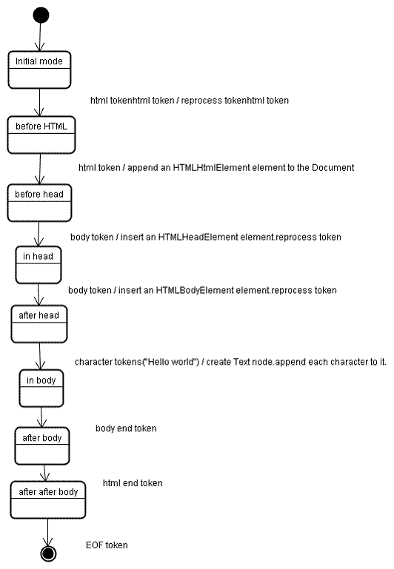

Slide 12
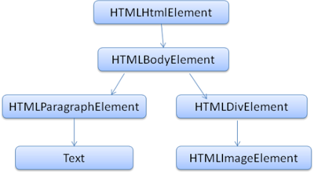
HTML Parsing - Example
<html>
<body>
<p>
Hello World
</p>
<div> <img src="example.png"/></div>
</body>
</html>

Slide 13
Injecting HTML
Imagine a situation where the HTML is rendered dynamically server-side:
<?php
<html>
<body>
Hello $_GET[“name”]
</body>
</html>
?>

Slide 14
Injecting HTML
If you go to http://example.com/index.php?name=bob the response is:
<html>
<body>
Hello bob
</body>
</html>
The resulting tokens looks like this:
html
body
“H” through “b” characters
body end
html end
end of file
The resulting tree looks like this:
+---------------+
|HTMLHtmlElement|
+-----+---------+
|
|
+-----v---------+
|HTMLHeadElement|
+-----+---------+
|
|
+-----v---------+
|HTMLBodyElement|
+-----+---------+
|
|
+--v---+
| Text |
+------+

Slide 15
Injecting HTML
If you go to http://example.com/index.php?name=<p>steve</p> the response is:
<html>
<body>
Hello <p>steve</p>
</body>
</html>
The resulting tokens looks like this:
html
body
paragraph
“s” through “e” characters
paragraph end
body end
html end
end of file
The resulting tree looks like this:
+---------------+
|HTMLHtmlElement|
+-----+---------+
|
|
+-----v---------+
|HTMLHeadElement|
+-----+---------+
|
|
+-----v---------+
|HTMLBodyElement|
+-----+---------+
|
|
+--------v-----------+
|HTMLParagraphElement|
+--------+-----------+
|
|
+--v---+
| Text |
+------+

Slide 16
Injecting HTML
If you go to http://example.com/index.php?name=<script>alert(0)</script> the response is:
<html>
<body>
Hello <script>alert(0)</script>
</body>
</html>
The resulting tokens looks like this:
html
body
“H” through “o” character tokens
script
“a” through “)” character tokens
script end
body end
html end
end of file
The resulting tree looks like this:
+---------------+
|HTMLHtmlElement|
+-----+---------+
|
|
+-----v---------+
|HTMLHeadElement|
+-----+---------+
|
|
+-----v---------+
|HTMLBodyElement|
+-----+---------+
|
|
+------+----------+
|HTMLScriptElement|
+------+----------+
|
|
+--v---+
| Text |
+------+

Slide 17
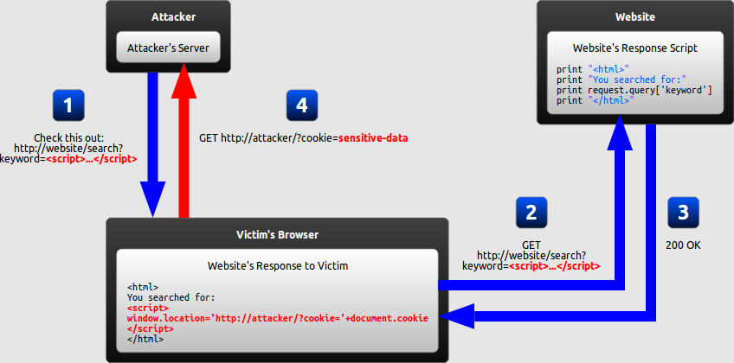
How it works (reflected)

Slide 18
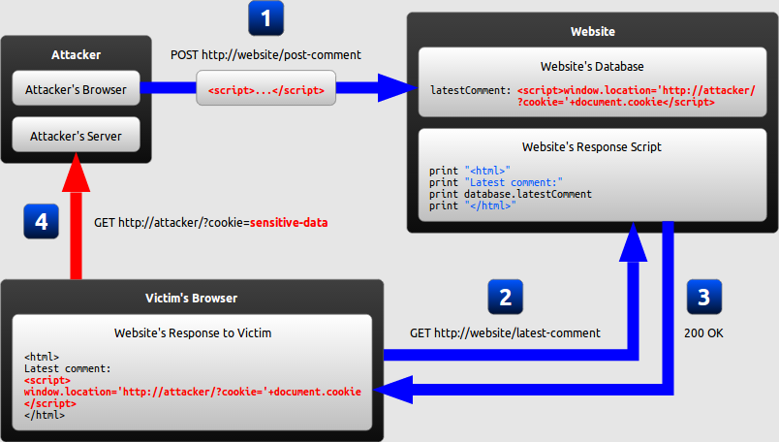
How it works (stored/persistent)

Slide 19
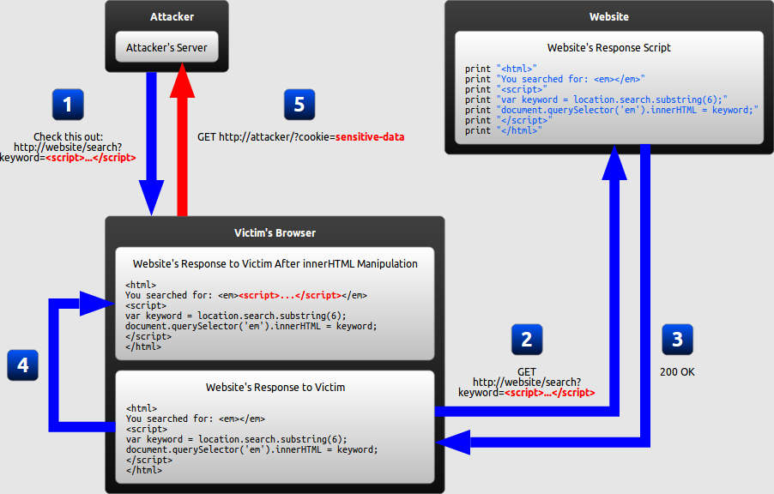
How it works (DOM based)

Slide 20
demo

Slide 21
Why it’s so common
Most sites consume a lot of user input
Web 2.0 means web applications
Used to be extra work to sanitize everything
Now it happens by default for newer frameworks
A lot of old code out there
Devs doing weird things
Functionality > security for most

Slide 22
Why it’s bad
5 major attacks
Stealing session tokens
Faking login form
Inducing user action
Keylogging
Client-side exploits

Slide 23
How to find it
Place input in all the variables you can
Use something sufficiently unique (farm animals)
See what is reflected back onto the page
See what characters you can get through
Figure out what you can do with the space you have and the characters you can get through
Filter evasion

Slide 24
How to mitigate it
HTML Encoding
< becomes &lt;
> becomes &gt;
“ becomes &quote;
‘ becomes &apos;
Things look okay in browser
This will neutralize the attack
Browser mitigations (good job Chrome!)
Validate input: regex [A-Za-z0-9+\s]+
Use mature frameworks and don’t be “clever”

Slide 25
References
Big thanks to: http://taligarsiel.com/Projects/howbrowserswork1.htm

